Slide 1
LogSentry: AI-Based Server Log Analysis and Performance Surveillance
Roll numbers
2420030132 2420030279 2420030529 2420030425
Python | Streamlit | scikit-learn | Plotly

Slide 2
Abstract
Server logs grow fast, and reading them line by line to find problems is slow. LogSentry is a web application that analyzes an uploaded log file and flags the entries that need attention. Each line is parsed for its timestamp and level, grouped into a category, and checked two ways: a rule that marks every ERROR and CRITICAL line, and an Isolation Forest model that spots lines unlike the rest of the file. Results appear in a Streamlit dashboard with charts, tables and a downloadable CSV report. On a 15-line sample file, LogSentry caught all 3 errors and flagged 7 entries for review.
2
detection methods
4
features per log line
5
issue categories

Slide 3
Introduction
Every server and app writes logs: timestamped records of what happened and when. They hold the first signs of failed logins, crashed services and resource problems.
A busy system writes thousands of lines an hour, and nobody can read them all.
LogSentry does the first pass. It highlights what looks wrong and leaves the final call to a person.
09:02:30 WARNING High memory usage detected
09:04:20 ERROR Database connection failed
09:08:20 ERROR Multiple failed login attempts
09:12:30 ERROR Service unavailable
Lines from sample_logs.txt (date left out to fit)

Slide 4
Problem statement
Reading logs by hand
LogSentry
Thousands of lines per hour
A keyword search only finds words you already know to look for
Raw text gives no overall picture
Reads and structures the file automatically
Adds a model that spots lines unlike the rest
Summarizes everything in charts and tables

Slide 5
Objectives
1
Parse logs
2
Apply rules
Turn raw text into a table with time, level and category
Mark every ERROR and CRITICAL line for review
3
Find odd lines
4
Show results
Use Isolation Forest to flag unusual patterns
Dashboard with charts, tables and a CSV report

Slide 6
Technologies used
Python
Pandas
Scikit-learn
Main language for the whole project
Holds the parsed log lines in a table
Isolation Forest anomaly model
Plotly
Streamlit
VS Code
Bar, pie and timeline charts
Turns the code into a web dashboard
Editor used to write and run it

Slide 7
How it works
1
2
3
4
5
Upload
Parse
Categorize
Detect
Display
.txt/.log file
Time and level
Keyword match
Rules + ML
Charts and CSV
Rule check
Isolation Forest
Every ERROR or CRITICAL line is marked Review required.
Scores message length, error words, warning words and digit count. Lines that are easy to isolate are labeled Unusual pattern.

Slide 8
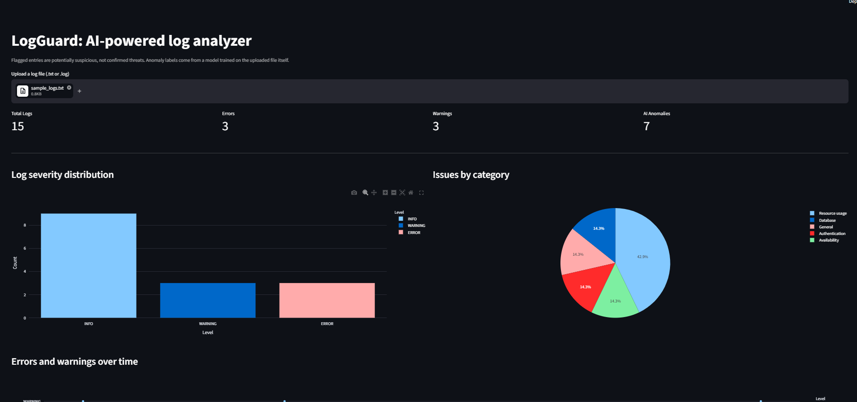
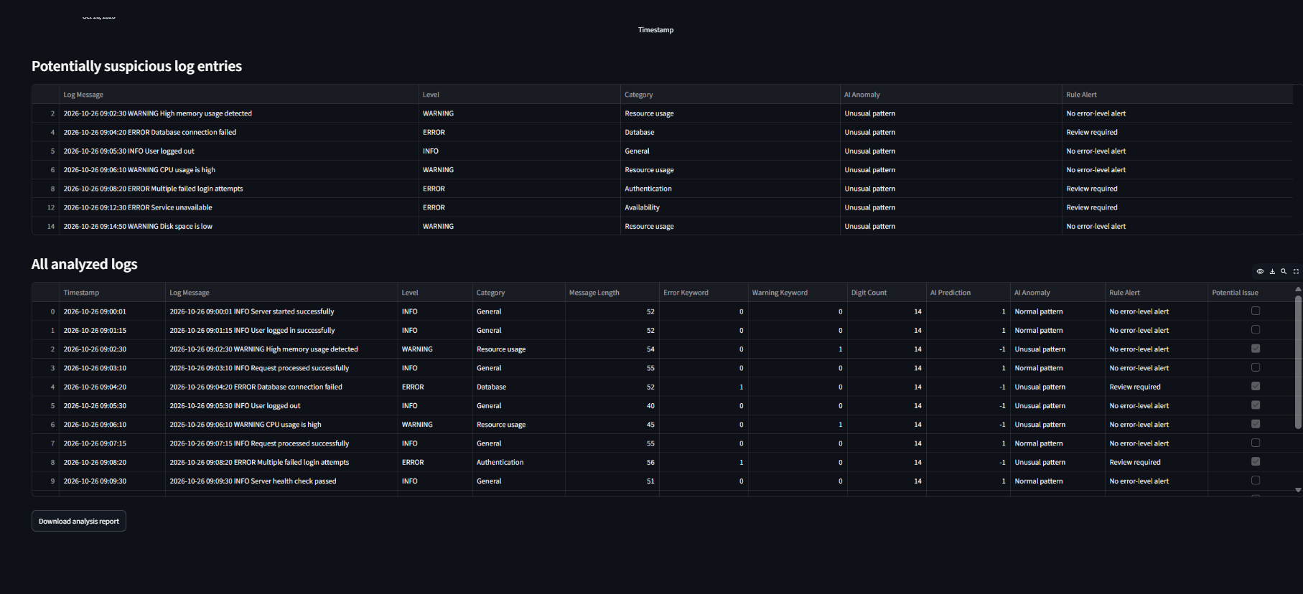
Results on the sample file
15
3
3
7
Total logs
Errors
Warnings
AI anomalies
Dashboard and flagged entries from sample_logs.txt

Slide 9
Limitations
!
Small samples
!
Basic features
15 lines give the model little to learn from. It flagged 7, even a plain INFO line.
The model sees four simple numbers, not the meaning of the words.
!
Fixed keywords
!
Timestamp format
Categories use set keywords, so other wording lands in General.
The timeline needs dates like 2026-10-26 09:00:01 in each line.

Slide 10
Future scope
1
2
3
4
Text features
More formats
Live monitoring
Alerts
Use TF-IDF so the model reads the words themselves
Support Apache, syslog and JSON logs
Watch a log stream instead of uploaded files
Send an email or message when an error appears

Slide 11
Conclusion
LogSentry shows that simple rules and an unsupervised model can work together to cut down the lines a person has to read.
On the sample file it caught all 3 errors, plus 4 other lines for a person to check. Its flags are suggestions, not verdicts, so a human still makes the final call.

Slide 12
Thank You

